Slide 1
Building the business migration case with Windows Server and SQL Server
September 2022

Slide 2
Abstract and learning objectives
In this whiteboard design session, you will look at how to design for converting/extending an existing IaaS deployment for resiliency. Throughout the whiteboard design session, you will look at the various configuration options and services to help build resilient architectures.
At the end of the workshop, you will be better able to design and use resiliency concepts including high availability with Availability Zones, disaster recovery for virtual machines to another region using Azure Site Recovery, and SQL Server high availability and disaster recovery using AlwaysOn Availability Groups. You will also learn how to assess the availability SLA, RPO and RTO of your design, and how to use Azure Backup to protect and secure your SQL data and VMs against corruption and loss.
You will also discuss how to achieve a similar level of resiliency for a PaaS-based implementation the same application, based on Azure App Service and Azure SQL Database. Finally, you will consider the costs associated with both approaches.

Slide 3
Step 1: Review the customer case study
Outcome
Analyze your customer needs.
Timeframe
15 minutes

Slide 4
Customer situation
Tailspin Toys is a global manufacturer of children’s toys headquartered in Milwaukee, WI
They are currently hosting mission critical workloads in on-premises datacenter
Kaylee Frye, CTO of Tailspin, has already had their Technical Architects create an assessment of their current environment, of which they’ve already identified apps and workloads to migrate first.
Their workloads are primarily Windows Server and SQL Server VMs
Their on-premises environment consists of over 250 servers and VMs and are hosted using Hyper-V

Slide 5
Customer situation - continued
They’ve identified some initial workloads they’d like to migrate first including Window Server VMs hosting .NET Framework applications and SQL Server databases.
They’ve also identifies some additional workloads that will remain on-premises but would like to ease their management burden.

Slide 6
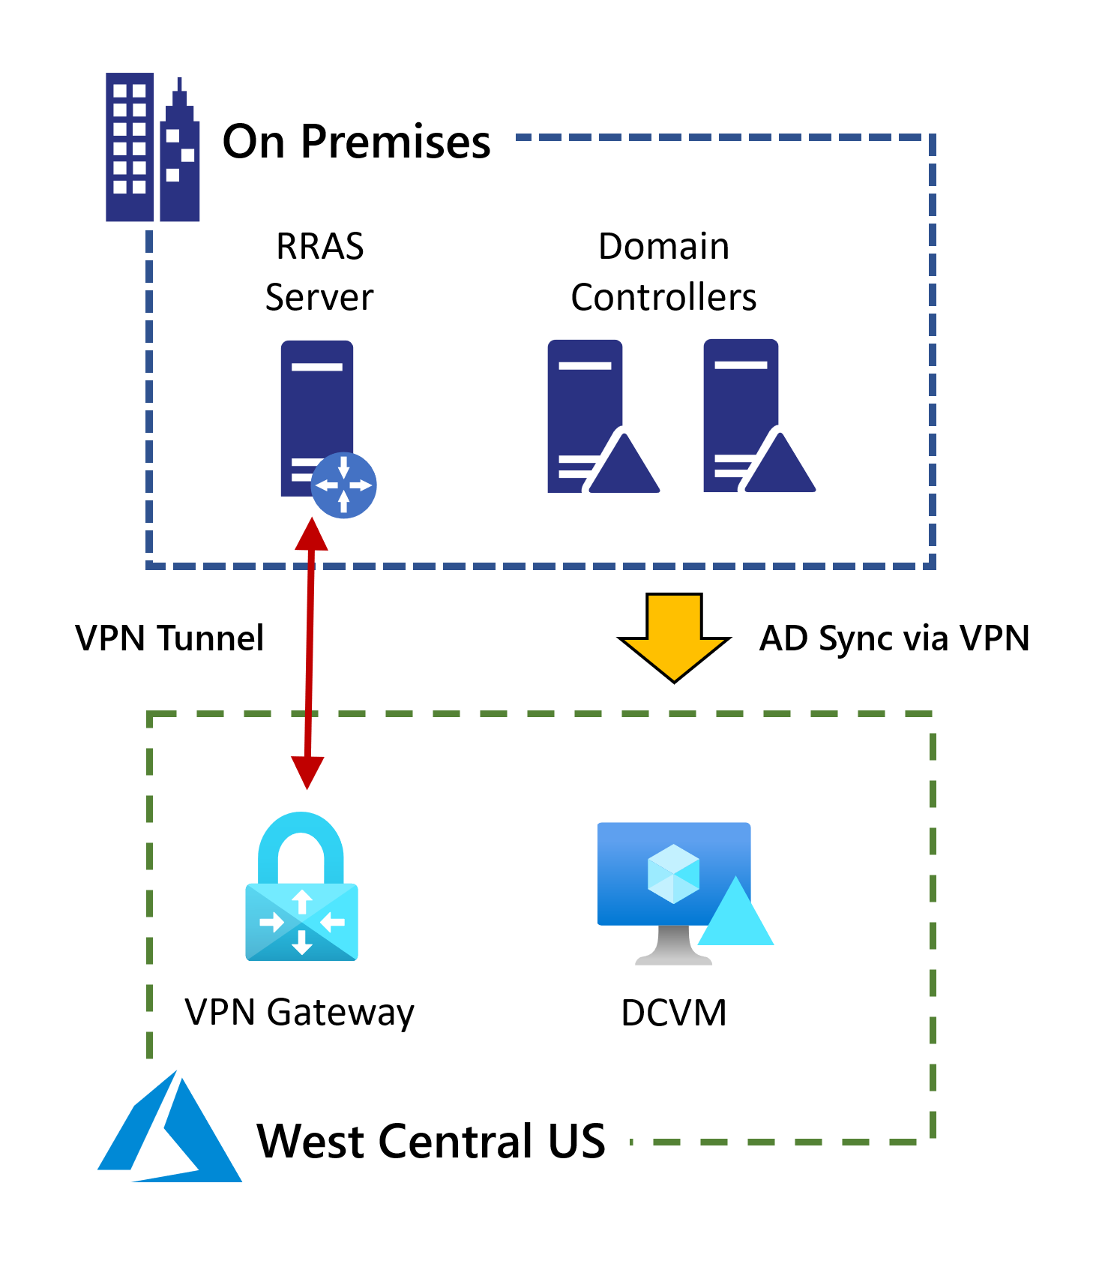
Current Active Directory Configuration
Currently have a single domain controller deployed in west central US
Connectivity is enabled with a site-to-site VPN gateway

Slide 7
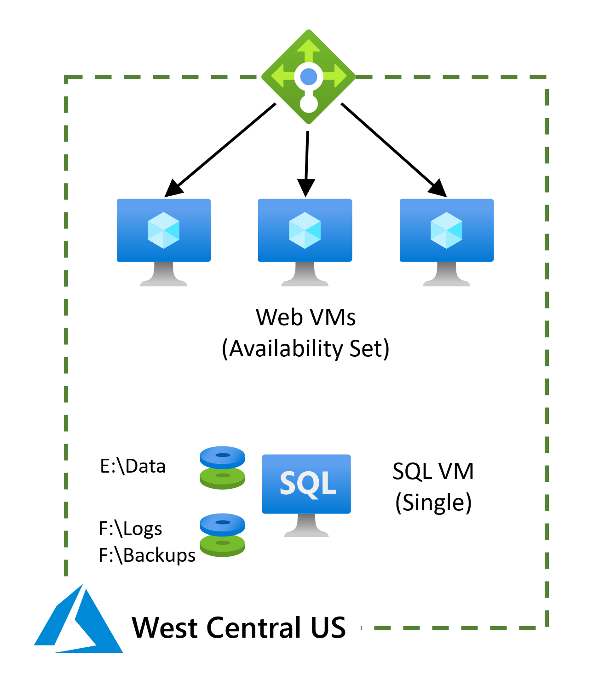
Current configuration for claims application
Web servers deployed into an availability set
SQL Server backend (single VM)
West Central US

Slide 8
Customer needs
Migrate existing workloads to Azure as efficiently as possible.
Lower the management burden with a consolidated view to manage VMs and Servers across Azure and on-premises
Network security is extremely important as we integrate on-premises networking with Microsoft Azure

Slide 9
Customer needs - continued
?
?
?
Contoso also want to fully understand the costs associated with each of 1 – 6 above.

Slide 10
Customer objections
It appears there are multiple options of hosting SQL databases in Azure. What's the best option to choose, and how do you know it'll be compatible?
What kind of downtime will be incurred when migrating the Windows Server and SQL Server workloads to Azure?
Will we be able to rollback to the on-premises VMs if the migration fails?

Slide 11
Customer objections (continued)
Tailspin has negotiated an Enterprise Agreement (EA) with Microsoft for their Azure consumption. Any cost estimates need to reflect their EA discount.
Would there be further savings from the use of PaaS services?

Slide 12
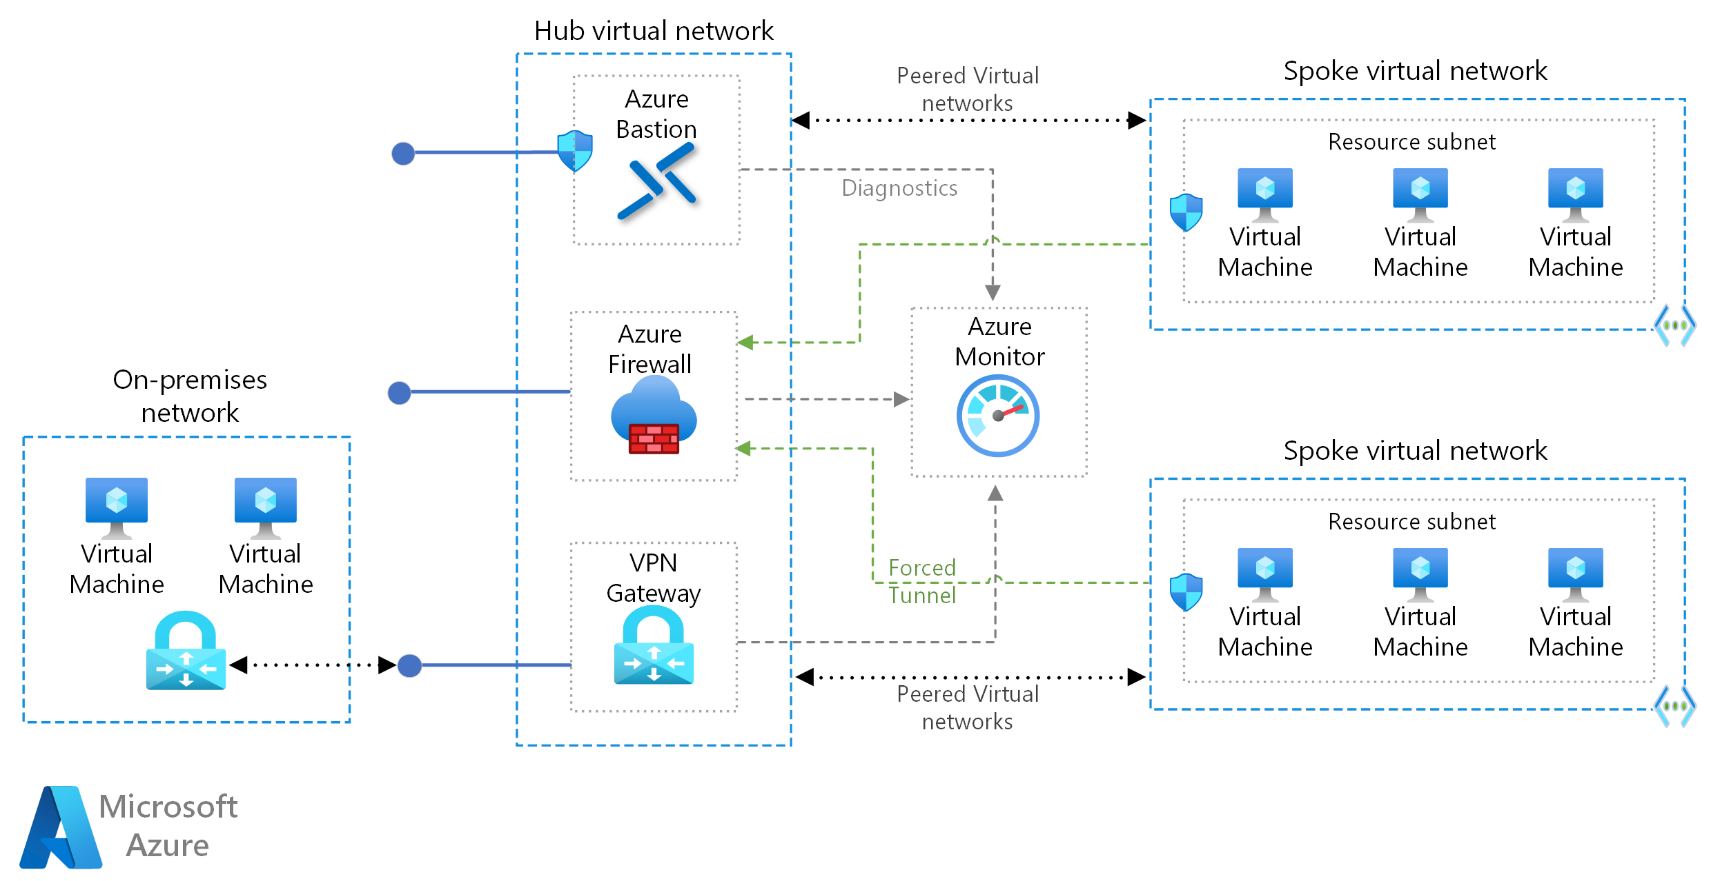
Common scenarios

Slide 13
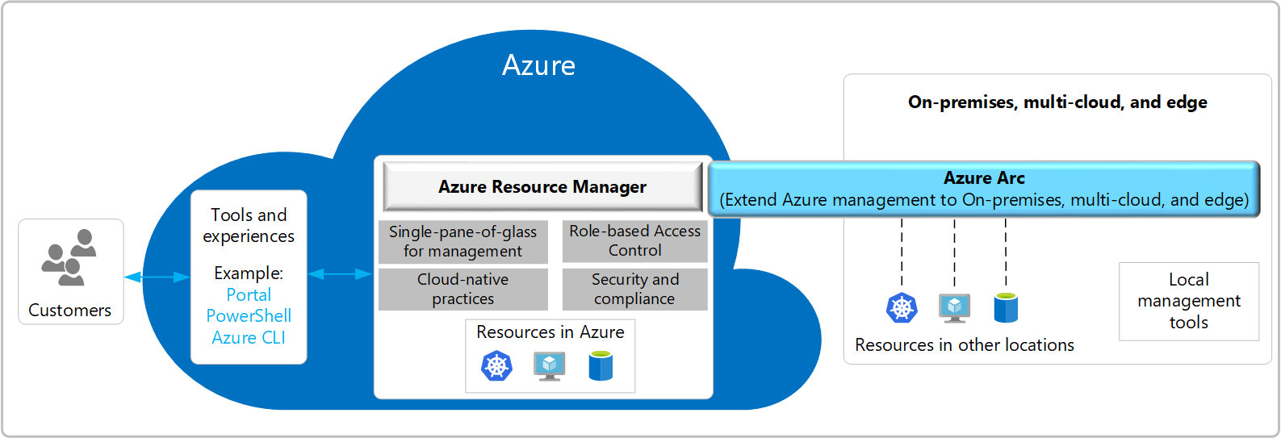
Common scenarios

Slide 14
Step 2: Design the solution
Outcome
Design a solution and prepare to present the solution to the target customer audience in a 15-minute chalk-talk format.
Timeframe
1-2 hours
Business needs | Respond to questions outlined in your student guide and be prepared to present your solution to others.
Design | Design a solution for as many of the requirements in your student guide as time allows.
Pricing | Provide an estimate of the costs associated with each aspect of your solution, following the questions in your student guide.
Prepare | Identify any customer needs that are not addressed with the proposed solution. Identify the benefits of your solution. Determine how you will respond to the customer’s objections. Prepare for a 15-minute presentation to the customer.

Slide 15
Step 3: Present the solution
Outcome
Present a solution to the target customer in a 15-minute chalk-talk format.
Timeframe
30 minutes (15 minutes for each team to present and receive feedback)
Directions
Pair with another team.
One group is the Microsoft team and the other is the customer.
The Microsoft team presents their proposed solution to the customer.
The customer asks one of the objections from the list of objections in the case study.
The Microsoft team responds to the objection.
The customer team gives feedback to the Microsoft team.
Switch roles and repeat Steps 2-6.

Slide 16
Wrap-up
Outcome
Review the preferred solution for the case study.
Timeframe
15 minutes

Slide 17
Preferred target audience
Kaylee Frye, CTO
Technical Architects

Slide 18
Solution Outcome 1
?
?
?

Slide 19
Solution Outcome 2
?
?
?

Slide 20
Customer objections
Objection
?
Potential answer
?
?

Slide 21
Customer quote
“?”
— Kaylee Frye, CTO, Tailspin Toys

